Slide 1

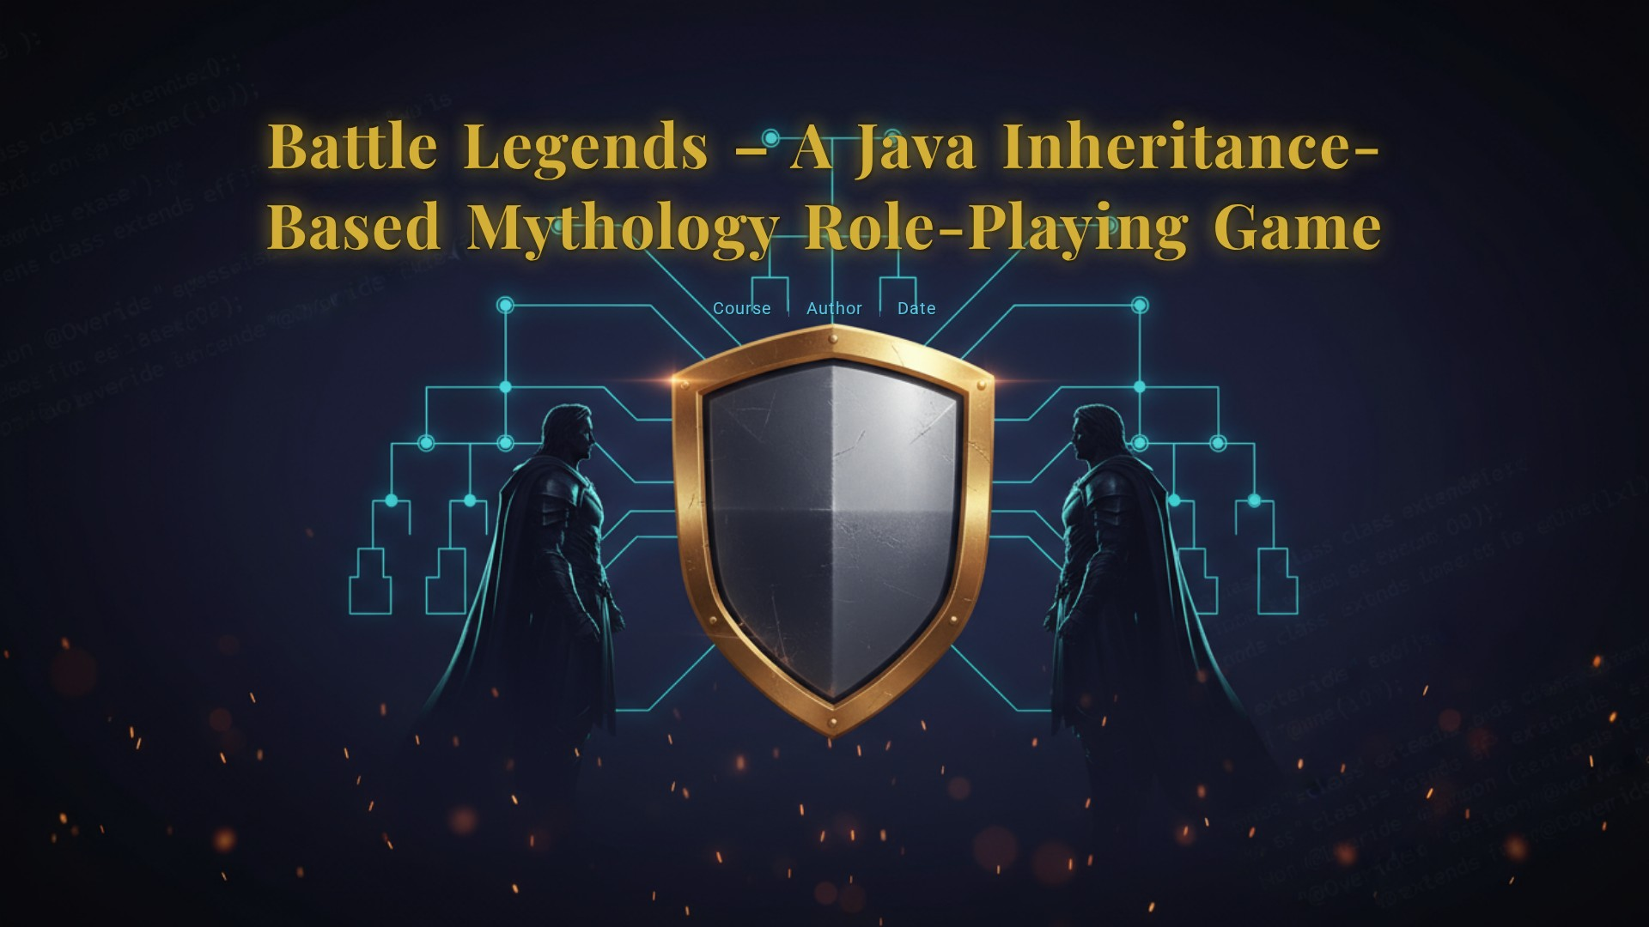
i

Slide 2

CONTENTS
1. Project Scenario
2. Objective
3. Key Concepts
4. Code for Battle Legends Game
5. Input and Output
6. Explanation of Code

Slide 3





1. Project Scenario
In ancient Bharat, during the age of epic wars and divine beings, six mythological heroes rise to protect righteousness (Dharma) and restore peace. The heroes include:
1
Arjuna
2
Karna
Master archer of the Pandava clan.
Invincible warrior with divine armor.
3
Krishna
4
Bhima
Supreme deity guiding warriors and strategizing battles.
Mighty Pandava known for immense strength.
5
Dhanvantari
6
Hanuman
Divine healer of gods.
Devotee with unmatched strength and loyalty.
The player takes the role of one of these heroes and battles against randomly chosen opponents in the Kurukshetra Arena of Legends. Each hero has unique attacks and defenses inspired by their mythological powers.
Every battle is unpredictable — strength, strategy, and divine blessings determine the outcome. Only the hero who masters their abilities can become the ultimate legend of Bharat.

Slide 4


2. Objective
The main goal of this project is to:
Demonstrate the concept of inheritance in Java.
Show how multiple subclasses can inherit properties and behaviors from a single base class.
Illustrate method overriding, where each subclass modifies inherited behavior to suit its unique role.
Provide an interactive, fun, and text-based role-playing game environment.

Slide 5





3. Key Concepts
1
2
Inheritance
Method Overriding
All hero types inherit from the base class Character.
Subclasses provide their own implementation of attack() and defend() methods.
3
4
Abstraction
Randomization
The base class Character is abstract and defines common templates for all heroes.
Random class is used to assign attack power, making battles unpredictable.
5
User Interaction
Scanner class allows players to choose heroes, enter names, and continue or quit rounds.

Slide 6

4. Code for Battle Legends Game
import java.util.*;
abstract class Character {
String name;
Character(String name) { this.name = name; }
abstract String attack();
abstract String defend();
}
// ===== Mythological Character Classes =====
class Arjuna extends Character {
Arjuna(String n){ super(n); }
String attack(){ return name + " shoots arrows from Gandiva 🎯"; }
String defend(){ return name + " blocks with divine armor 🛡️"; }
}

Slide 7
4. Code for Battle Legends Game
class Karna extends Character {
Karna(String n){ super(n); }
String attack(){ return name + " fires celestial arrows 🌟"; }
String defend(){ return name + " deflects attacks with Bhargava armor 🛡️"; }
}
class Krishna extends Character {
Krishna(String n){ super(n); }
String attack(){ return name + " strikes with Sudarshan Chakra 🔱"; }
String defend(){ return name + " creates magical illusions ✨"; }
}

Slide 8
4. Code for Battle Legends Game
class Bhima extends Character {
Bhima(String n){ super(n); }
String attack(){ return name + " smashes silently with mace 🗡️"; }
String defend(){ return name + " dodges using immense strength 💨"; }
}
class Dhanvantari extends Character {
Dhanvantari(String n){ super(n); }
String attack(){ return name + " emits divine healing light 🌸"; }
String defend(){ return name + " heals instantly 💖"; }
}

Slide 9
4. Code for Battle Legends Game
class Hanuman extends Character {
Hanuman(String n){ super(n); }
String attack(){ return name + " smashes with mighty strength 💥"; }
String defend(){ return name + " absorbs all damage with divine power 🦁"; }
}
// ===== Main Game Class =====
public class BattleLegends {
public static void main(String[] args) {
Scanner sc = new Scanner(System.in);
Random rand = new Random();

Slide 10
4. Code for Battle Legends Game
System.out.println("🌟 WELCOME TO ⚔️ BATTLE LEGENDS – INDIAN MYTHOLOGY EDITION 🌟");
System.out.print("Enter your hero name: ");
String playerName = sc.nextLine();
String[] heroTypes = {
"Arjuna 🎯",
"Karna 🌟",
"Krishna 🔱",
"Bhima 🗡️",
"Dhanvantari 💖",
"Hanuman 💥"
};

Slide 11
4. Code for Battle Legends Game
// Player selects their own type
System.out.println("\nChoose your hero type:");
for (int i = 0; i < heroTypes.length; i++)
System.out.println((i+1) + "️⃣ " + heroTypes[i]);
int playerChoice = 0;
while (true) {
System.out.print("Enter hero type (1–6): ");
if (sc.hasNextInt()) {
playerChoice = sc.nextInt();
if (playerChoice >= 1 && playerChoice <= 6) break;
else System.out.println("❌ Invalid choice. Please enter a number between 1 and 6.");
}

Slide 12
4. Code for Battle Legends Game
else {
System.out.println("❌ Invalid input. Please enter a number.");
sc.next(); // clear invalid input
}
}
sc.nextLine(); // clear buffer
// Player selects enemy type
System.out.println("\nChoose your enemy's type:");
for (int i = 0; i < heroTypes.length; i++)
System.out.println((i+1) + "️⃣ " + heroTypes[i]);
int enemyChoice = 0;

Slide 13
4. Code for Battle Legends Game
while (true) {
System.out.print("Enter enemy type (1–6): ");
if (sc.hasNextInt()) {
enemyChoice = sc.nextInt();
if (enemyChoice >= 1 && enemyChoice <= 6) break;
else System.out.println("❌ Invalid choice. Please enter a number between 1 and 6.");
} else {
System.out.println("❌ Invalid input. Please enter a number.");
sc.next(); // clear invalid input
}
}

Slide 14
4. Code for Battle Legends Game
sc.nextLine(); // clear buffer
// Assign character instances based on selections
Character player = switch (playerChoice) {
case 1 -> new Arjuna(playerName);
case 2 -> new Karna(playerName);
case 3 -> new Krishna(playerName);
case 4 -> new Bhima(playerName);
case 5 -> new Dhanvantari(playerName);
case 6 -> new Hanuman(playerName);
default -> throw new IllegalStateException("Unexpected value: " + playerChoice);
};

Slide 15
4. Code for Battle Legends Game
String enemyName = heroTypes[enemyChoice - 1].split(" ")[0]; // e.g., "Arjuna" from "Arjuna 🎯"
Character enemy = switch (enemyChoice) {
case 1 -> new Arjuna(enemyName);
case 2 -> new Karna(enemyName);
case 3 -> new Krishna(enemyName);
case 4 -> new Bhima(enemyName);
case 5 -> new Dhanvantari(enemyName);
case 6 -> new Hanuman(enemyName);
default -> throw new IllegalStateException("Unexpected value: " + enemyChoice);
};

Slide 16
4. Code for Battle Legends Game
System.out.println("\nYou have chosen: " + player.getClass().getSimpleName() + " (" + player.name + ")");
System.out.println("Enemy: " + enemy.getClass().getSimpleName() + " (" + enemy.name + ")");
System.out.println("\n⚔️ " + player.name + " vs " + enemy.name + " ⚔️");
System.out.println("🔥 Let the mythological battle begin! 🔥");
int pScore = 0, eScore = 0;
int round = 1;

Slide 17
4. Code for Battle Legends Game
while (round <= 5) {
System.out.println("\n🌪️ Round " + round + " begins!");
System.out.println(player.attack());
System.out.println(enemy.defend());
System.out.println(enemy.attack());
System.out.println(player.defend());
int p = rand.nextInt(50) + 1;
int e = rand.nextInt(50) + 1;
System.out.println("\n🎲 Power — " + player.name + ": " + p + " | " + enemy.name + ": " + e);

Slide 18
4. Code for Battle Legends Game
if (p > e) {
System.out.println("🏆 " + player.name + " wins this round!");
pScore++;
} else if (e > p) {
System.out.println("💀 " + enemy.name + " dominates this round!");
eScore++;
} else {
System.out.println("🤝 Draw! Both heroes fought equally!");
}
System.out.print("\n👉 Do you want to continue to the next round? (y/n): ");
String choice = sc.nextLine().trim().toLowerCase();
if (!choice.equals("y")) {
System.out.println("\n🛑 You decided to quit early!");
break;

Slide 19
4. Code for Battle Legends Game
}
round++;
}
System.out.println("\n🏁 FINAL SCORE → " + player.name + ": " + pScore + " | " + enemy.name + ": " + eScore);
System.out.println("======================================");
if (pScore > eScore)
System.out.println("🎉 Victory! " + player.name + " becomes a mythological legend!");
else if (eScore > pScore)
System.out.println("😢 " + enemy.name + " defeats you. Train harder!");
else
System.out.println("🤝 It's a tie! Both heroes are equally powerful!");
System.out.println("\n🍀 Thanks for playing Battle Legends – Mythology Edition!");
sc.close();
}
}

Slide 20
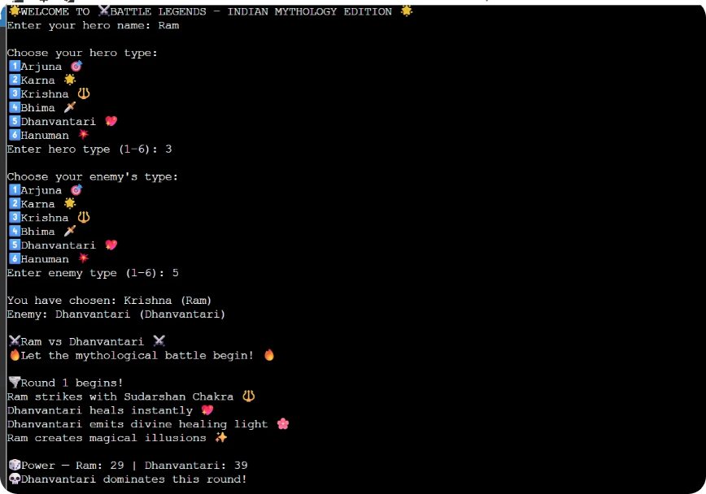
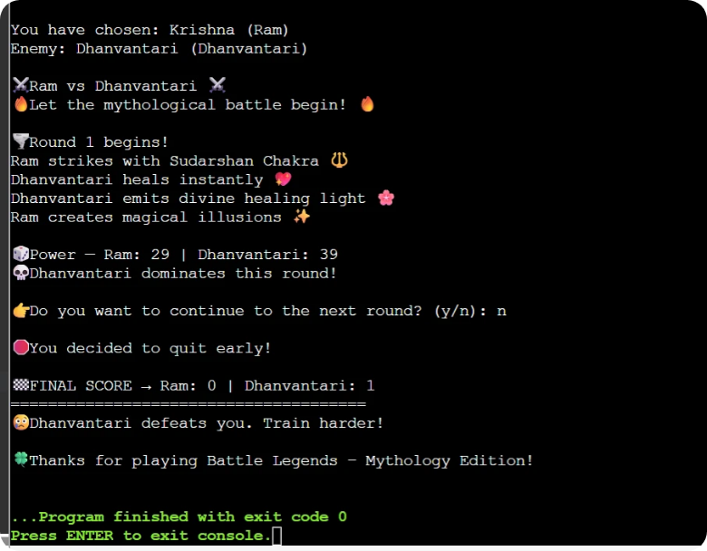
5. Input and Output

Slide 21


6. Explanation of Code
Battle Legends – Indian Mythology Edition is a Java-based console game set in ancient Bharat, during an era when epic wars and divine beings shaped the fate of the world. Players step into the Kurukshetra Arena of Legends, choosing from six legendary heroes — Arjuna, Karna, Krishna, Bhima, Dhanvantari, and Hanuman — each embodying unique mythological abilities and virtues rooted in Dharma.
Every battle tests the hero’s strength, strategy, and divine blessings. Arjuna commands celestial archery, Karna wields invincible armor, Krishna uses divine wisdom and illusions, Bhima relies on brute strength, Dhanvantari heals with divine energy, and Hanuman channels unmatched devotion and power. The game’s combat system uses random power generation to simulate the unpredictability and divine intervention of mythological warfare.
Through multiple rounds of combat, the player faces off against chosen or random opponents. Victory depends not only on raw strength but also on the will to protect righteousness. The ultimate goal is to triumph in the arena and become the Eternal Legend of Bharat, symbolizing the triumph of light, valor, and Dharma.

Slide 22
6. Use of Inheritance and Polymorphism in the code
What is Inheritance?
Inheritance allows one class to acquire features (variables and methods) from another class.
This helps in code reusability and avoids rewriting the same logic again.
How Inheritance is Used Here
You created an abstract parent class character
All other mythological characters extend this class.
abstract class Character {
String name;
Character(String name) { this.name = name; }
abstract String attack();
abstract String defend();
}
Child classes (Arjuna, Karna, Krishna, Bhima, Dhanvantari, Hanuman) inherit the common features from character
class Arjuna extends Character {
Arjuna(String n){ super(n); } // Calls parent constructor
String attack(){ return name + " shoots arrows from Gandiva 🎯"; }
String defend(){ return name + " blocks with divine armor 🛡️"; }
}

Slide 23
6. Use of Inheritance and Polymorphism in the code
What is Polymorphism?
Polymorphism means one interface → multiple forms.
A parent reference can point to any child object and call the child’s overridden methods.
Where Polymorphism is used in the code
Character player = switch (playerChoice) {
case 1 -> new Arjuna(playerName);
case 2 -> new Karna(playerName);
case 3 -> new Krishna(playerName);
case 4 -> new Bhima(playerName);
case 5 -> new Dhanvantari(playerName);
case 6 -> new Hanuman(playerName);
};
Here:
Player is of Character (parent) type
But it holds different child class objects based on selection
player.attack();
enemy.defend();
The correct version of the method runs depending on the actual object type, not the reference type.

Slide 24

Thank You

